Slide 1

Collabor8
Making postsecondary CS education a welcoming and collaborative space
Notes:
Team intro: names
Our theme: post-secondary CS education

Slide 2
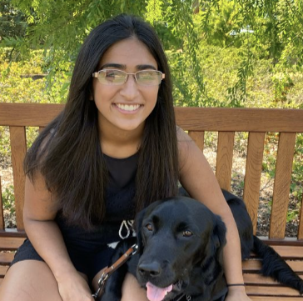



The Collabor8 Team
Trisha K.
Daniel R.
Juliette W.
Angela C.

Slide 3

“When starting out, being able to form connections and feeling a sense of belonging is crucial in staying involved.”
— Sery Junior CS Major and CS intro class TA at OSU,

Slide 4
Initial POV
WE MET Sery, a Junior CS major and TA at OSU
WE WERE AMAZED TO REALIZE that her strong feeling of community in her intro class was crucial in deciding to do CS, yet she worked independently in later classes
IT WOULD BE GAME-CHANGING TO create a community and encourage mutually beneficial collaboration in (intro) CS classes

Slide 5








Additional Interviewees
Students
Educators
Year
Cathy
Prof. Lizard
Anita
Sery
Carolyne
Prof. Yak
José
Prof. Mink
CS experience

Slide 6

“People here are really focused on the more computational type skills than they are their soft skills.”
— Anita CS senior at Purdue, 3 internships
Notes:
Recurring theme about representation and impostor syndrome, collaboration in industry

Slide 7

“This game theory didn't work: students do not think rationally.”
— Prof. Yak ECE professor at a public university with 16 years of teaching experience
Notes:
It is basically peer teaching.
The difficulty with group projects is that people are getting credit for work that they don't do.
In workplace settings, it's very rare for people to work by themselves, and so, people do have to work in groups.
This game theory didn't work: students do not think rationally.
It's interesting that for something that's so marginal in terms of grades, people are really willing to put in the effort to do it.
I think people do not think rationally about the assessments.
As you weight percentages differently, I think students don't really try to optimize.
Do we really need to do the weightings the way we do them because the students actually don't care about the weightings.
There's a whole bunch of irrationality here that I think is really fascinating.

Slide 8


“If you can talk your way through that with someone and teach someone else how to do it... then that really solidifies your understanding of the material.”
— Prof. Lizard CS lecturer at a private university
Computer Systems
Probability
Notes:
Being able to give students that sense of agency in their programming... I think that's incredibly important.
I kind of just want everyone to be very comfortable with whatever learning suits them
This practice of teaching, I think, is incredibly important in solidifying your own understanding of the material
When you're working with other people, you kind of feel this community of responsibility to make sure that you can move on to the next task
If you can talk your way through that with someone and teach someone else how to do it... then that really solidifies your understanding of the material.
Not every student is comfortable with talking with a complete stranger about something that they don't know.

Slide 9

“At some level, you have to learn the basics for yourself to make sure that you're facile to contribute to a team.”
— Prof. Mink Professor and Associate Chair for Education in CS at a private university
Notes:
Working in a pair in industry doesn't really mean you work you produce the code faster. It means you produce more robust code.
At some level, you have to learn the basics for yourself to make sure that you're facile to contribute to a team

Slide 10
Collaboration is key to CS education regarding learning effectiveness, resources, and preparation for careers.
Students value collaboration that promotes independent growth and fosters relationship building.

Slide 11
POV 1
WE MET Cathy, a grad student at Stanford who just began taking CS classes last year with no previous CS background
WE WERE AMAZED TO REALIZE that she was most stressed by not being able to start because of tool trouble
IT WOULD BE GAME-CHANGING TO make students feel more supported when starting out and eliminate any roadblocks before further learning

Slide 12
How might we make every student feel comfortable about basic knowledge and confident to move on to further learning?

Slide 13
Solution: A dynamic student-editable FAQ/class wiki

Slide 14


Prototype 1
Peer Teaching
Concept
Concept
Assumptions:
Teaching helps one understand a concept
Correct understanding of a concept won’t get lost in translation
Novices are uniquely situated to teach other novices

Slide 15
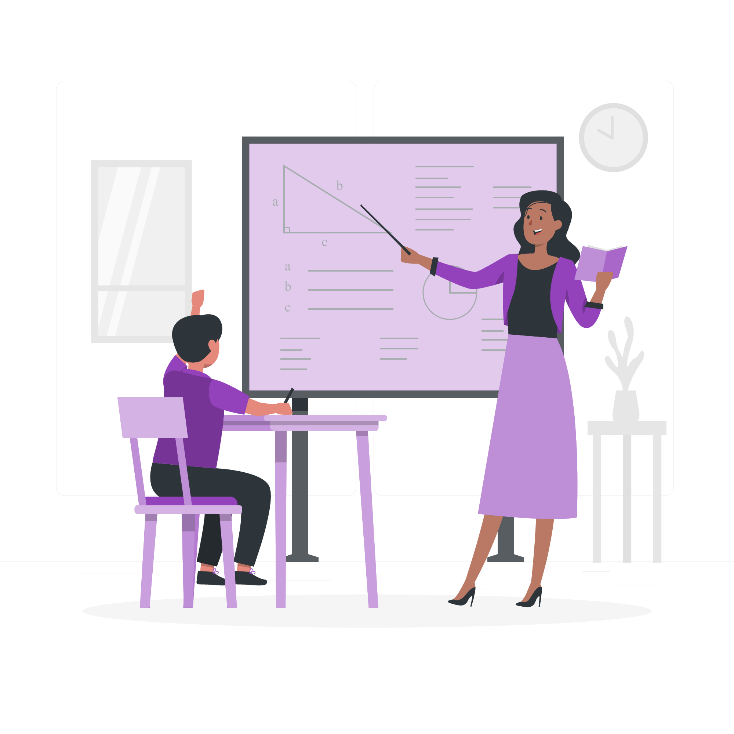
Prototype 1 Peer Teaching
Teaching is a nerve-wracking experience
More active learning; very rewarding
“I was kinda nervous because this concept is brand new.”
“I felt nervous teaching another person.”
“He taught the concept the exact same way I taught him!”
“I was more focused when learning, knowing that I’ll have to teach it.”
“The more questions my ‘student’ asks, the more fulfillment I get.”
“I’d love to have a study group like this!”

Slide 16
POV 2
WE MET Carolyne, a Junior CS major at Yale
WE WERE AMAZED TO REALIZE she likes to work by herself to avoid feeling like an impostor even if it means spending much more time and effort on assignments
IT WOULD BE GAME-CHANGING TO create collaborative spaces that don’t foster impostor syndrome

Slide 17
How might we make a space for collaboration where students feel safe?

Slide 18
Solution: Randomized anonymous group work

Slide 19



Prototype 2
Anonymous Collaboration
Assumption: Anonymity encourages less stressful collaboration

Slide 20

Prototype 2 Anonymous Collaboration
Not a huge stress relief for people who don’t experience imposter syndrome
It’s fair, efficient, and helpful for coding interviews
“I think it’s a great way to prepare me to code in front of strangers like in coding interviews.”
“If I’m stuck with the same group all semester, I’d want good teammates. This constantly switching is fair for everyone, so I don’t care about others’ skill levels.”
“I’m comfortable with or without anonymity”

Slide 21
POV 3
WE MET Prof. Mink, the chair of his institution’sCS department, who has developed and taught the introductory CS course there for the past 14 years
WE WERE AMAZED TO REALIZE that he does not feel pair programming/collaborative coding in the intro CS courses is beneficial to student learning in practice even though he recognizes the benefits of collaboration while working in industry in this field
IT WOULD BE GAME-CHANGING TO create a collaborative environment that is in the best interest of student learning while also preparing students for the collaborative coding that happens in industry / group work.

Slide 22
How might we encourage equal contribution from collaborators?

Slide 23
Solution: Alternate small parts of a larger process

Slide 24
Prototype 3
Alternate Line Coding vs. Natural Collaboration
gp_to_gc = {}
Sure!
Okay, I’ll write the code, and you check for errors.
for parent, listofchildren in parents_to_children.items():
for child in listofchildren:
for parent, listofchildren in parents_to_children.items():
Assumptions:
Forced alternating input results in a more balanced collaboration
More balanced collaboration leads to more beneficial learning outcomes for both participants

Slide 25

Prototype 3 Alternate Line Coding
Not suitable for more complex problems, doesn’t encourage communication
A fun, productive activity that fosters a more balanced collaboration
“It was such a fun activity!”
“It helps me explore other solutions I hadn’t thought of.”
“It’s good that both of us need to understand the problem.”
“It doesn’t resemble how it works in the real world.”
It’s hard to build personal connections.

Slide 26
Our Solution
The three prototypes address different needs: community building, independent thinking, etc.
Combination
The three solutions complement each other pedagogically
All three prototype tests were generally successful and well-received

Slide 27



Summary
Collaboration and peer-teaching helps students solidify their understanding
Anonymity can encourage student participation
Alternating small parts can lead to mutual understanding
Notes:
Collaboration acts to reinforce a student’s understanding. Different students have different needs. Some students feel more comfortable in anonymous settings.

Slide 28
What questions do you have?

Slide 29
Appendix

Slide 30
Additional Needfinding Empathy Map 1
Say: “We created pair programming as a way to reduce the workload of section leaders” “If there aren’t tools that force the best practices of pair programming, it is easy to do it badly” “Most students just divide and conquer on the assignments, which isn’t what we are trying to teach them” “The 106s are courses where students need to develop code on their own to show individual comprehension of the material’ “It is easier to understand the importance of pair programming / the necessary dynamics when you are an upper level student” “Online learning makes courses with 500 people even more intimidating” “The percentage of women section leaders is higher than the percentage of women in the CS major”
Do: Actively tries to mitigate stereotype threat when teaching Provides lots of resources for students in his course Try to lower activation energy for students to get help in the course Assigns work that can be completed in a reasonable amount of time without a partner Makes changes to ease the workload of section leaders
Think: It is important that the gender ratios in the major and in sub cultures of the major are balanced Students need to work independently on assignments to prove individual knowledge Discussion sections are the place to get individual and personalized attention Individual attention is necessary to succeed in 106 courses Pair programming is necessary in industry Students feel more isolated from course staff in online learning Students want a space to collaborate with their peers Feel: The need to bring people together so that they don’t feel intimidated in such a large class The need to continually develop and improve the section leading program to best meet the needs of students Informed Justified

Slide 31
Additional Needfinding Empathy Map 2
Say “All of our coding assignments were individualistic with a very strict honor code.” “I felt like the most helpful thing was a lab for reiterating concepts.” “I got to meet a lot of friends in labs that I got to collaborate with in the future.” “If you don’t have any experience but you work next to someone who has, they might finish a lot quicker than you, and you would feel stressed out and fall behind.” “I realized that my experience was far less than other experienced peers.” “I found those who are more arrogant tend to not be the most patient or willing to help.” “People here are black and white kind of thinking.” “None of my CS classes gave me insights about my internship. I learned all that on my own.” “A lot of schools can do a better job explaining to students what career paths there are available for CS students.” “Teaching each other is really helpful in industry.” “Most ppl hate group projects, but they are the most helpful for preparing for the real world.“ “A lot of the girls I know come to CS and get scared so they switched majors.”
Do Meet students out of class but in the discipline for support. Prepare individually for job readiness. Explore careers and applications for computer science individually. Ultimately work in either software engineering industry or academia. Gains soft skills from liberal arts minor and other interests. Avoid arrogant people when seeking clarifications. Compare skill levels when in a new class. Teach each other when working in industry. Learn about tooling.
Think: Computer science is the hardest discipline. Higher Education institutions do not focus on teaching soft skills to computer science/engineering students like myself. Computer science was the best major fit for me. Working alone is worth avoiding arrogant people. Tooling education prepared me for industry. Groupwork was the most helpful learning approach in preparing for work in industry. My female friends dropped out of computer science because of intimidation. Fear of honor code violations prevent open collaboration. Technical qualifications are often overshadowed by an inability to communicate effectively. General education classes like public speaking are not legitimate at school. There are lots of opportunities to apply computer science in different ways.
Feel Independent Frustrated Rewarded Self-motivated Determined Empathetic Intellectually curious Confident in communication skills Reassured by industry experience Underrepresented Uninformed Competitive

Slide 32
HMW’s for POV 1
HMW provide individual help to beginners?
HMW remove the need for tools?
HMW make students comfortable struggling?
HMW get students to help each other through the process?
HMW integrate tool learning process into the regular learning process?
HMW remove the pressure to understand tools instantly?
HMW make the tools available and accessible for everybody?
How might we develop tooling skills separately from the assignments?
How might we increase efficiency of tool use earlier on in the quarter?
How might we eliminate setup time?
How might we better document challenges that students faced when getting their setup to work?
How might we create a better metric for evaluating healthy struggle versus unintuitive or unuseful effort to problem solve?
How might we create more instantaneous support for setup challenges?

Slide 33
HMW’s for POV 2
HMW increase students’ self confidence?
HMW level the playing field for students of varying abilities in collaborative environments?
HMW raise awareness of other students’ challenges?
HMW create anonymous collaboration opportunities?
HMW make students feel more comfortable sharing their vulnerabilities?
HMW create smaller communities in the CS department?
HMW match students with similar skill levels?
HMW make failing okay?
HMW eliminate arrogance in collaboration?
HMW get students to empathize with each other?
HMW eliminate the desire to compare yourself to your peers?
HMW make intro CS like a morgue (everyone’s equal)?

Slide 34
HMW’s for POV 3
How might we make pair programming support learning in intro CS classes?
HMW stimulate industry coding in intro CS pair-programming?
HMW create non-assignment spaces for collaboration?
HMW create a space where students can collaborate, but also learn individually?
HMW prevent the divide-and-conquer approach of pair programming?
HMW design assignments that require group work?
HMW we expedite building an individual student’s foundation?
HMW demonstrate individual learning while collaborating?
HMW appease an instructor’s goal to have all students know all the material in pair programming?
HMW learning CS like a tennis game (takes two people to play, but both need to be fully competent)?
HMW make students more excited about individual work?
HMW encourage all people to contribute to all parts of the process?
HMW find the right people to collaborate with?
HMW we make group work beneficial to learning but not harmful to performance evaluation?

